Slide 1

Manage.Mentorship
Jaisal, Daniel, and Gabriel

Slide 2
Overview
Introduction to the Mentorship Network
Communication, Planning, & Modeling
Construction
Deployment & Demo!

Slide 3
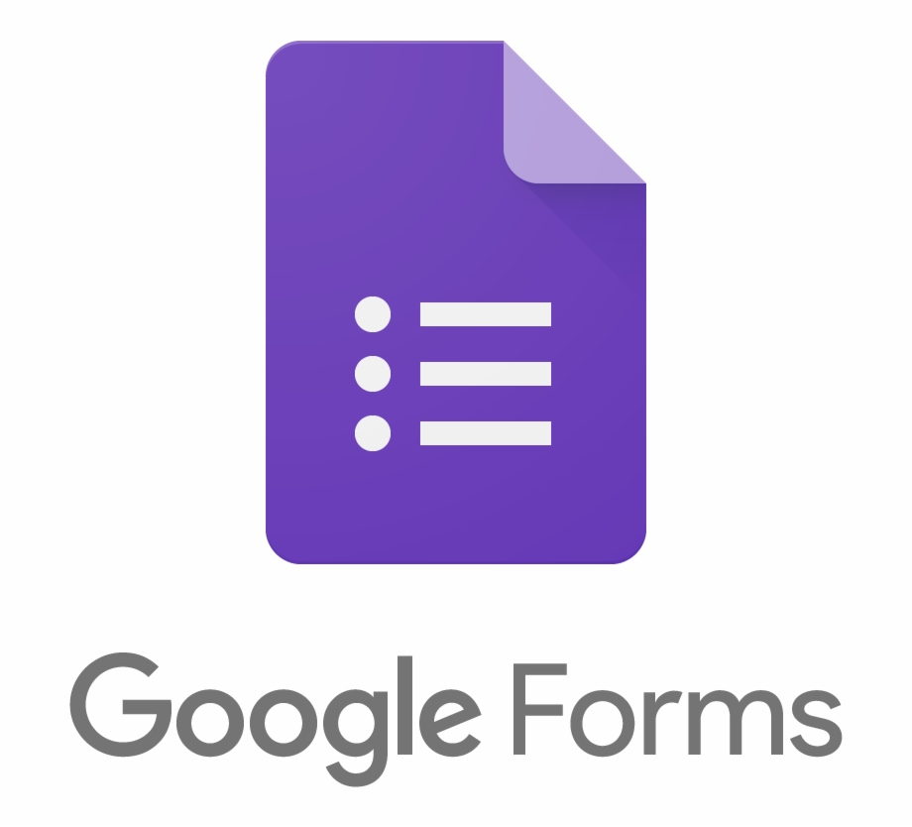


Communication, Planning, & Modeling
We decided to use the Agile Process Model. Using Github Projects we completed 3 sprints over the last month
The team members divided themselves as 1 PM, 1 PM/Developer, & 1 Developers
Used Slack to regularly communicate with the team and between team members
Gathered requirements from the Mentorship Board using Google Forms
Unique situation - 2 team members were also customers

Slide 4


Features!
Registration (Login/Logout) of System
Edit Users
Update Database (Add/remove entries)
Display Database
Check Database
Download Database
Send Emails
Generate Statistics
Submit Match Request
Resolve Match Requests

Slide 5
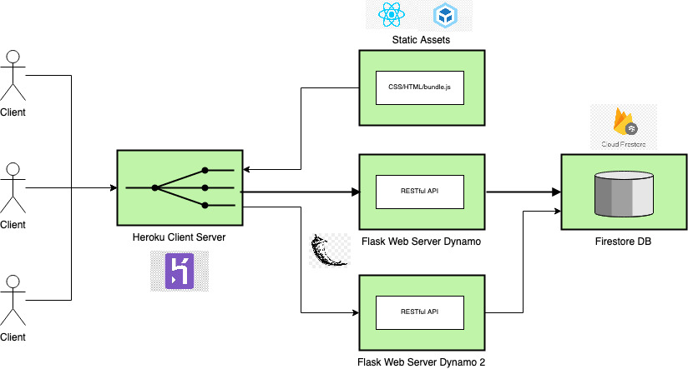
Construction
Notes:
Technical Architecture Decisions - NoSQL, React, Flask
Modern, responsive web application
Implemented about half of the requirements (but we had 7!)

Slide 6
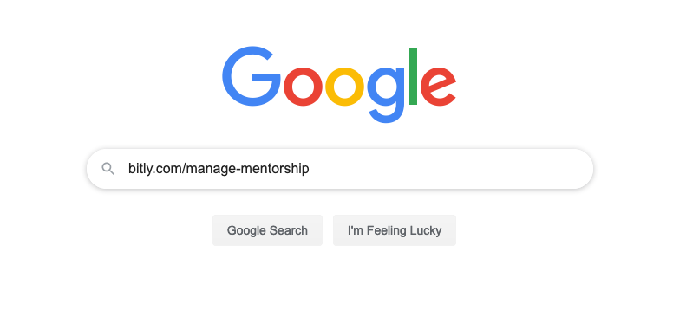
Deployment & Demo
Submit a request to connect with one of our mentors!
Notes:
Ngrok

Slide 7
Thank you!

